Slide 1

Hotel Reservation Analysis
Using SQL
Mentorness Internship Program
G .Guru Charan
MIP-DA-04

Slide 2

Agenda
Introduction
Problem Statement
Overview of Dataset
Questions
Recommendations

Slide 3
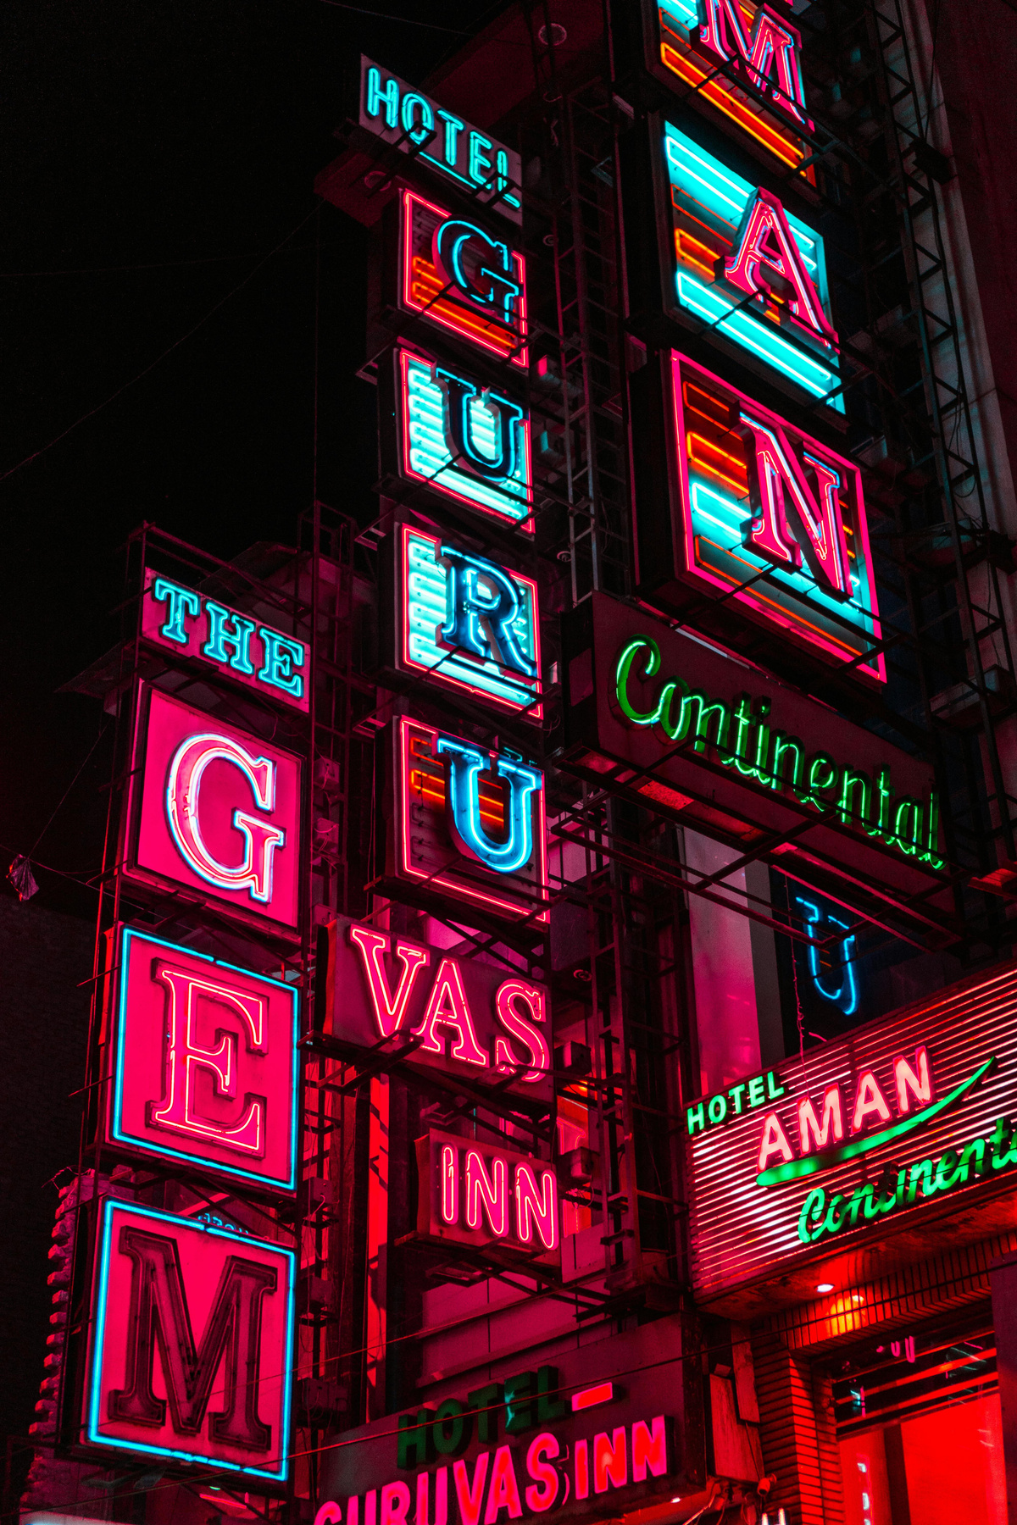
Introduction
The hotel industry relies on data to make informed decisions and provide a better guest experience.
In this project I worked with a hotel reservation dataset to gain insights into guest preferences, booking trends, and other key factors that impact the hotel's operations.
I used MySQL Workbench to analyze the data, as well as answer specific questions about the dataset.

Slide 4
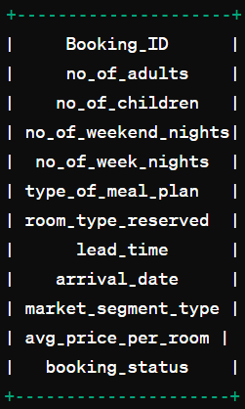

The datset includes the following columns :
Problem
Statement
There are 15 questions for which i wrote SQL queries to analyze the data.

Slide 5
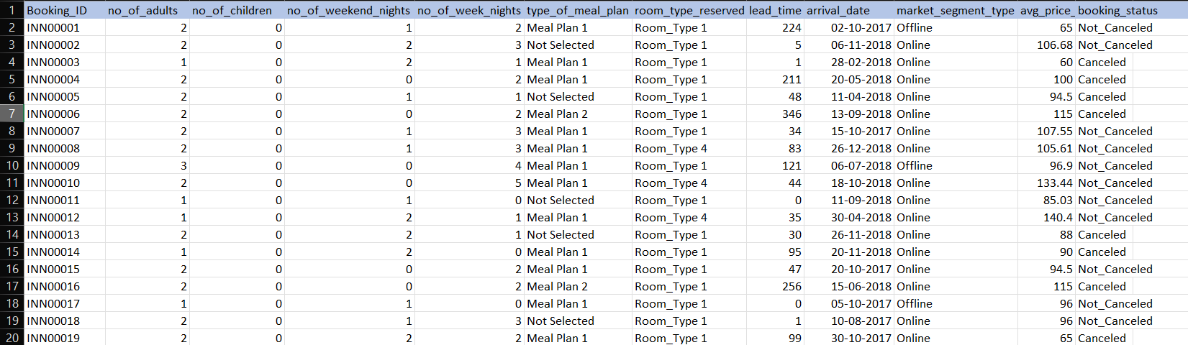
Overview of
Dataset

Slide 6

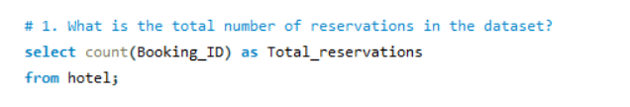

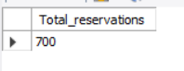
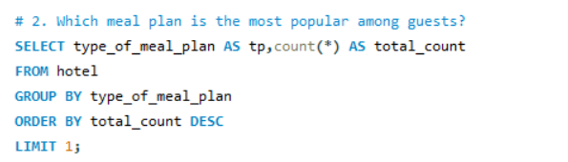
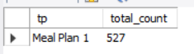
Questions
What is the total number of reservations in the dataset?
Which meal plan is the most popular among guests?
Results

Slide 7
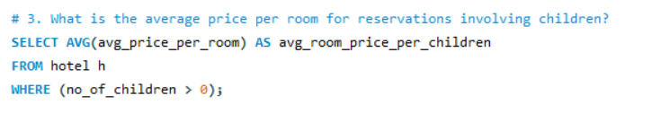
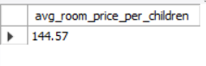
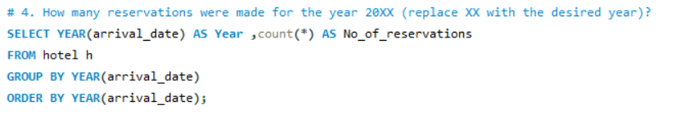
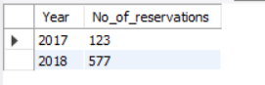
Questions
3. Which meal plan is the most popular among guests?
4. How many reservations were made for the year 20XX (replace XX with the desired year)?

Slide 8
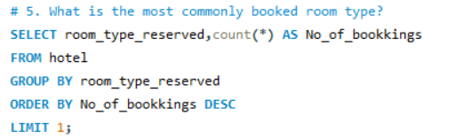
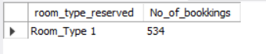
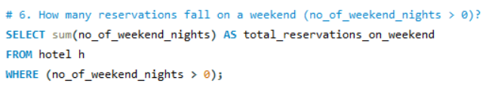
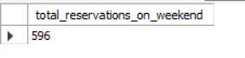
Questions
5. What is the most commonly booked room type?
6. How many reservations fall on a weekend (no_of_weekend_nights > 0)?

Slide 9
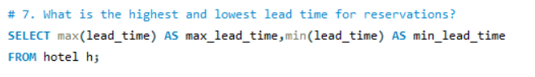
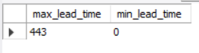
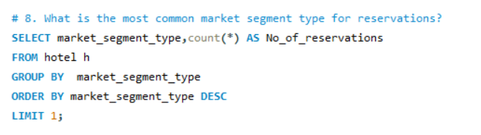
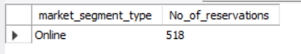
Questions
7. What is the highest and lowest lead time for reservations?
8. What is the most common market segment type for reservations?

Slide 10
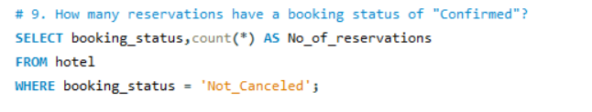
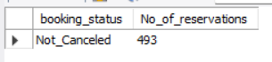
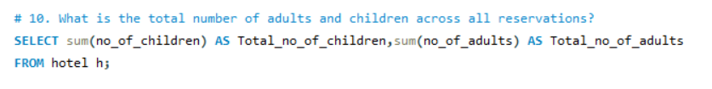
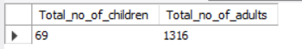
Questions
9. How many reservations have a booking status of "Confirmed"?
10. What is the total number of adults and children across all reservations?

Slide 11
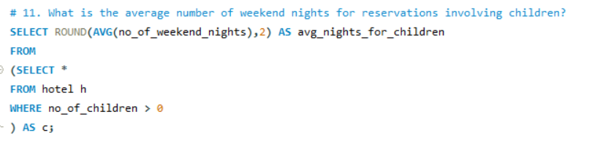
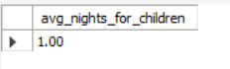
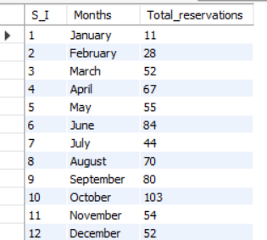
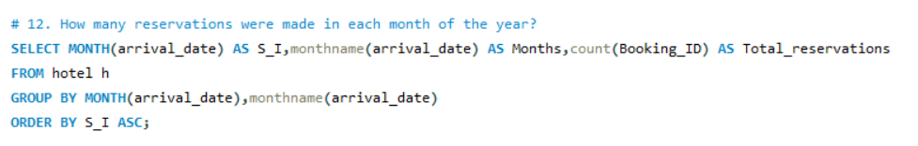
Questions
11. What is the average number of weekend nights for reservations involving children?
12. How many reservations were made in each month of the year?

Slide 12
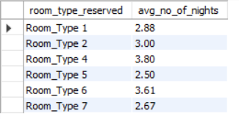
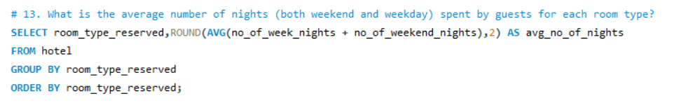
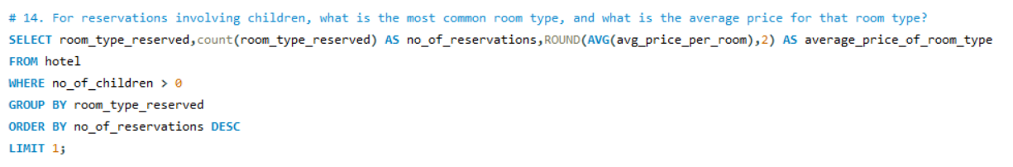

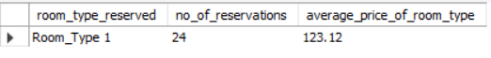
Questions
13. What is the average number of nights (both weekend and weekday) spent by guests for each room type?
14. For reservations involving children, what is the most common room type, and what is the average price for that room type?

Slide 13
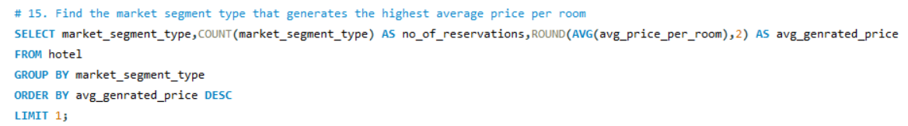
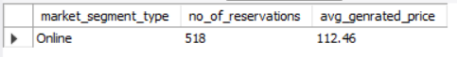
Questions
15. Find the market segment type that generates the highest average price per room

Slide 14

RECOMMENDATIONS
The average price per room reservations involving chiuldren is 42.91 units more than that of reservations not involving children
Number of reservations for Room_type_1 not involving children is 510 and involving children is 24 but the average price of room involving children is 27.45
Based on the analysis we can say that the hotel management can start campaigns that could attract families having children as there are more number of sale in that type of reservations. This could boost their sales by around 30% - 35% as long as the market stays the same .

Slide 15

THANK YOU !

